Slide 1
Customer Support Agent
SpaceKonceptRental
Demo path
RAG customer support workflow built with n8n, Google Drive, Pinecone, Google Sheets, Gmail, and OpenAI.
1. Ingest KB
2. Ask chatbot
3. Review Sheets
4. Trigger error path
Capstone goal
Answer FAQs, capture leads, create tickets, escalate issues, and log operations for review.
Presented by
Francies Cheng, Wei Jun, Sian Hwee
SpaceKonceptRental capstone
01

Slide 2
CAPSTONE REQUIREMENT
Customer support scope mapped to working automation
The brief asks for FAQ answers, bookings, tickets, escalations, and lead generation.
FAQ and pricing
Booking and leads
Tickets and escalation
Answers are grounded in the uploaded Markdown KB. Pricing questions are answered conservatively and routed for quote confirmation.
The agent collects contact details, rental purpose, dates, duration, items, delivery area, and budget where provided.
Damage, complaints, urgent delivery, or human handoff requests create follow-up records and Gmail alerts.
Knowledge base
Logging
Error handling
Google Drive stores cleaned Markdown files; ingestion creates Pinecone vectors in SpaceKonceptRental_kb.
Google Sheets records conversations, leads, tickets, unanswered questions, ingestion, and failures.
A global error workflow logs failures and sends alerts independently of normal chat flow.
SpaceKonceptRental capstone
02

Slide 3
SYSTEM ARCHITECTURE
Three local workflow exports cover the full support loop
Google Drive
Ingestion
Pinecone
Chat agent
Actions
Approved Markdown KB files
Drive trigger, chunking, embeddings
Namespace: SpaceKonceptRental_kb
Retrieval, strict JSON response
Sheets logging and Gmail alerts
Workflow exports
Operational records
1. Global Error Handler
2. KB Ingestion to Pinecone
3. RAG Customer Support Agent
conversations, leads, tickets, unanswered_questions, kb_ingestion, failures
SpaceKonceptRental capstone
03

Slide 4
RAG KNOWLEDGE DESIGN
Markdown files keep retrieval factual and easy to inspect
The old Q&A script was converted into KB-style reference material.
What changed
4
3
6
Intent and handoff labels were removed from the KB. Routing remains in the agent prompt and n8n IF nodes.
RAG-ready Markdown files
n8n workflow exports
Google Sheets log tabs
FAQ and service scope
Terms and privacy
Catalogue
Service overview, rental process, quote request details, delivery questions, and chatbot limits.
Draft policy material is separated and marked for business/legal review before production.
Product categories are summarised for broad answers; final availability and pricing still require team confirmation.
SpaceKonceptRental capstone
04

Slide 5
DEMO AND TEST PLAN
Presentation demo can show the full support loop
1. Ingest KB
2. Ask FAQ
3. Route actions
Upload kb/*.md to the Drive folder and run the ingestion workflow. Confirm Pinecone and kb_ingestion rows.
Ask how rental works. The answer should cite KB facts and complete a conversation row.
Ask booking, ticket, lead, pricing, and angry-customer prompts. Confirm Sheets and Gmail outputs.
4. Duplicate safety
5. Error path
Send the same message_id twice and confirm no duplicate business action.
Trigger a controlled failure and confirm the failures sheet plus Gmail alert.
SpaceKonceptRental capstone
05

Slide 6
READINESS STATUS
Ready for capstone walkthrough; not yet production deployment
Live route testing is complete for the capstone demo; remaining work is production hardening.
Ready for presentation
Live proof captured
Workflow JSON validates locally. KB files are cleaned and separated. Demo story maps to the official customer-support capstone deliverables.
End-to-end chatbot execution, Sheets logging, Gmail alerts, route coverage, and error handling evidence were captured for the walkthrough.
Before production
Capstone talking point
Confirm business/legal facts, replace draft policy markers, review security, monitor executions, and test website or WhatsApp deployment.
This is a practical n8n implementation of the brief: RAG answers, lead capture, ticketing, escalation, and operational logging.
SpaceKonceptRental capstone
06

Slide 7
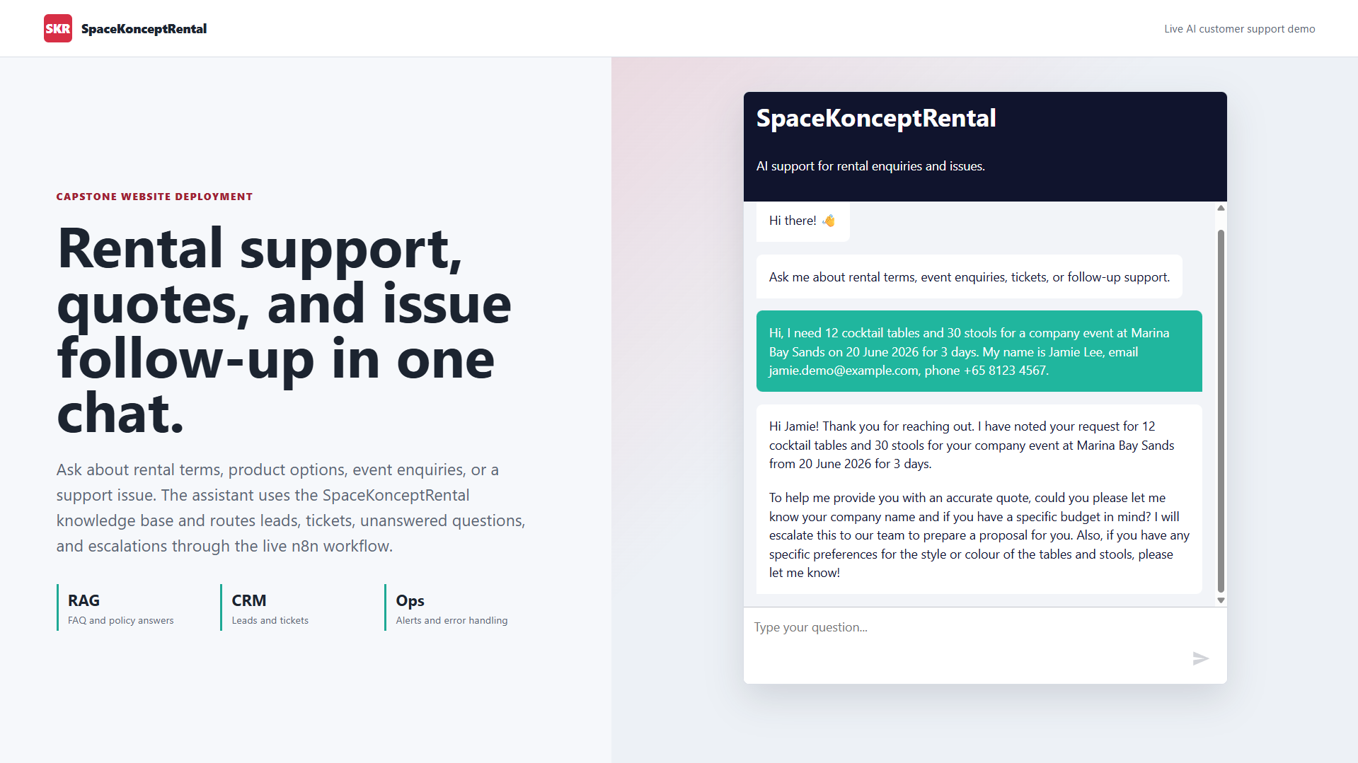
Website Chat Deployment
Customer submits a rental enquiry through the embedded website chatbot.
SpaceKonceptRental capstone evidence
07

Slide 8
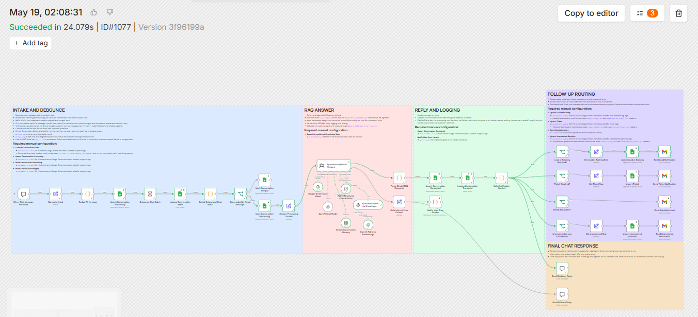
Customer Support Agent Workflow
Chat intake flows through debounce, RAG answer, logging, routing, notifications, escalation, and fallback.
SpaceKonceptRental capstone evidence
08

Slide 9
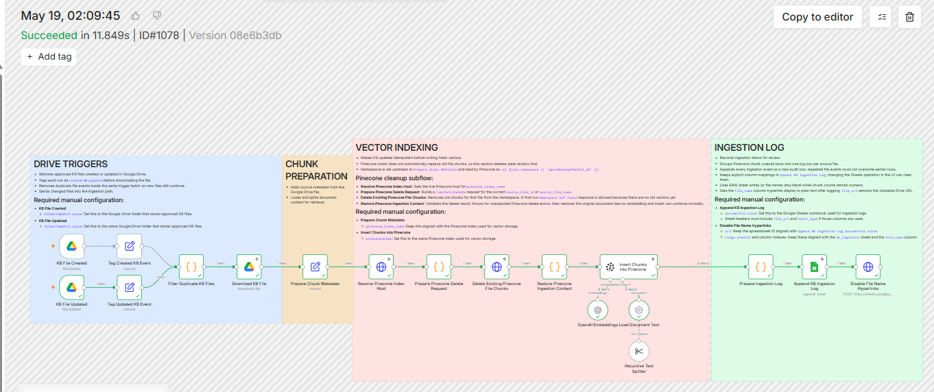
RAG Knowledge Base Ingestion
Google Drive KB files are prepared, cleaned, embedded, indexed in Pinecone, and logged for audit.
SpaceKonceptRental capstone evidence
09

Slide 10
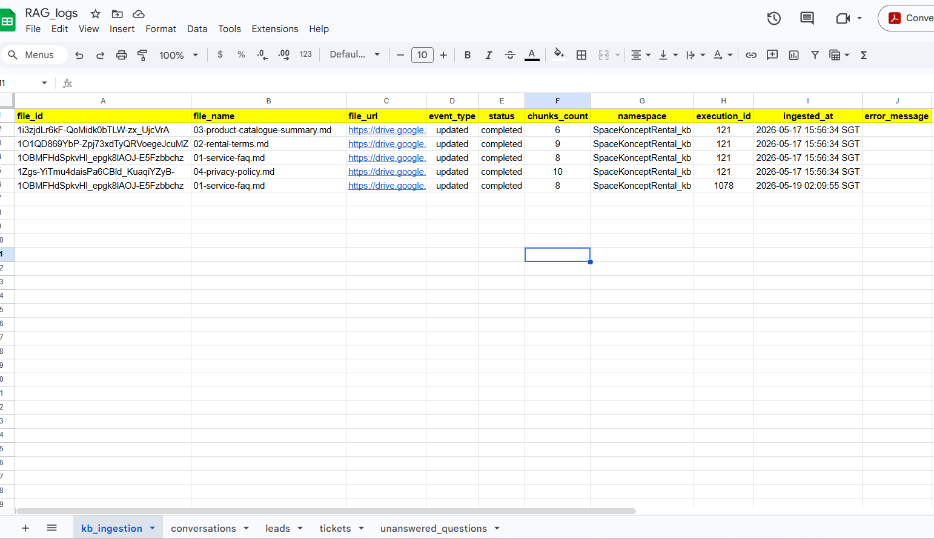
Ingestion Audit Log
Each KB update records file name, status, chunk count, namespace, execution ID, and SGT timestamp.
SpaceKonceptRental capstone evidence
10

Slide 11
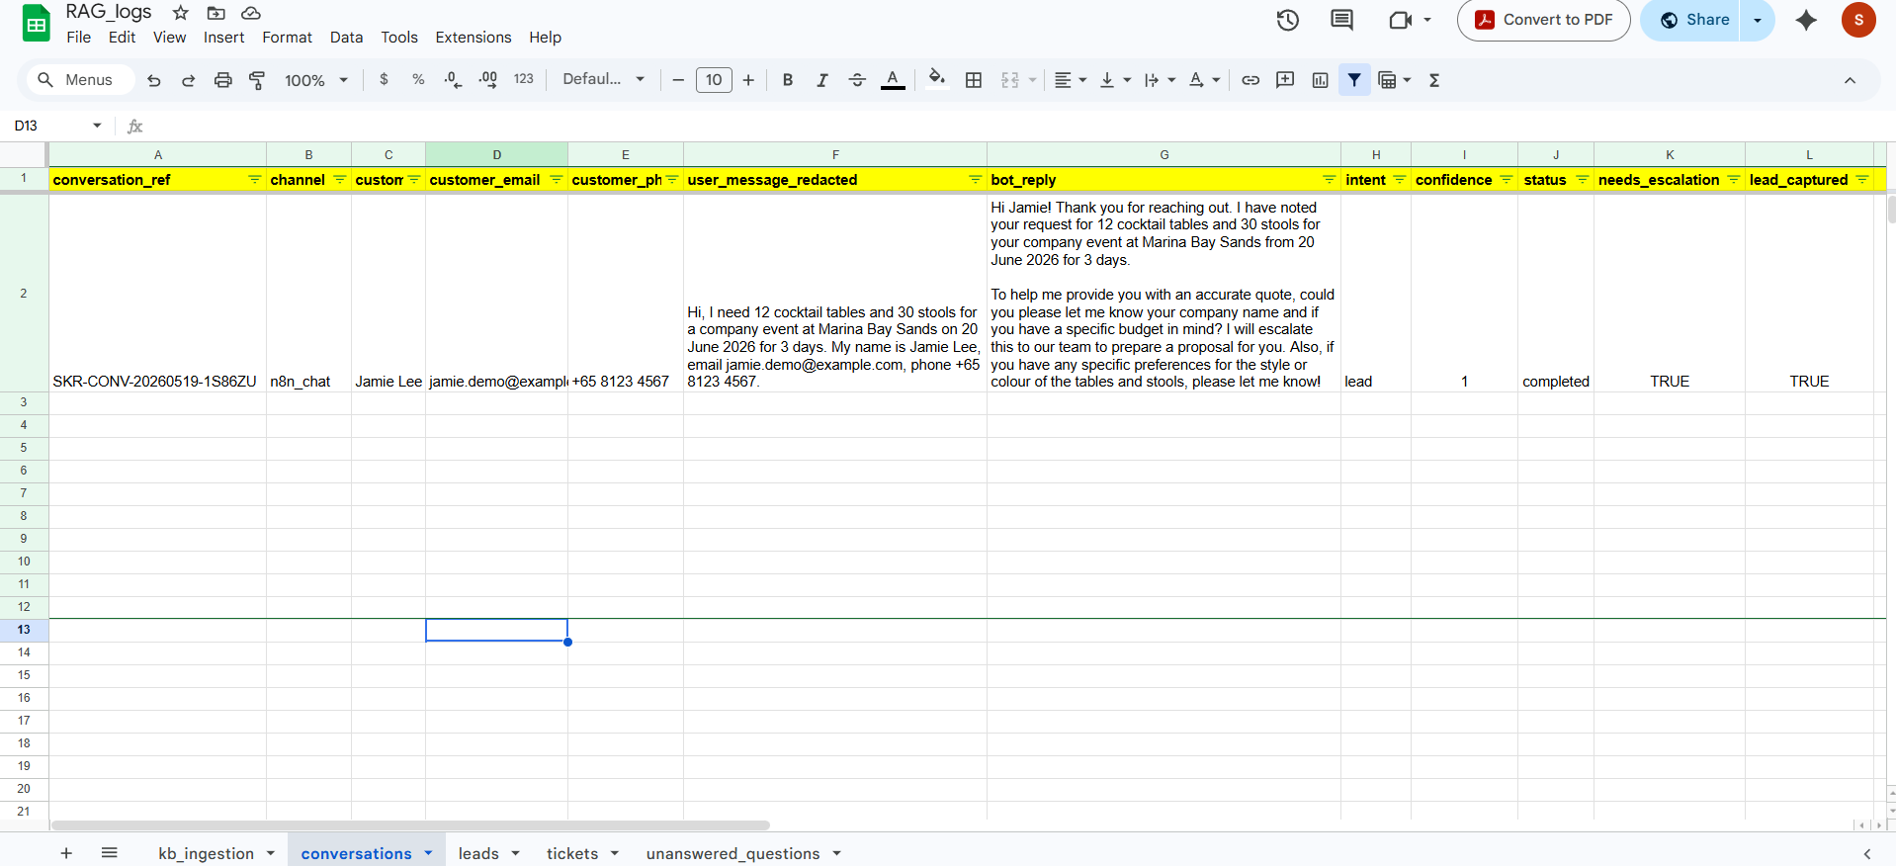
Conversation Log
The workflow stores the customer message, bot reply, intent, status, escalation flag, and lead capture result.
SpaceKonceptRental capstone evidence
11

Slide 12
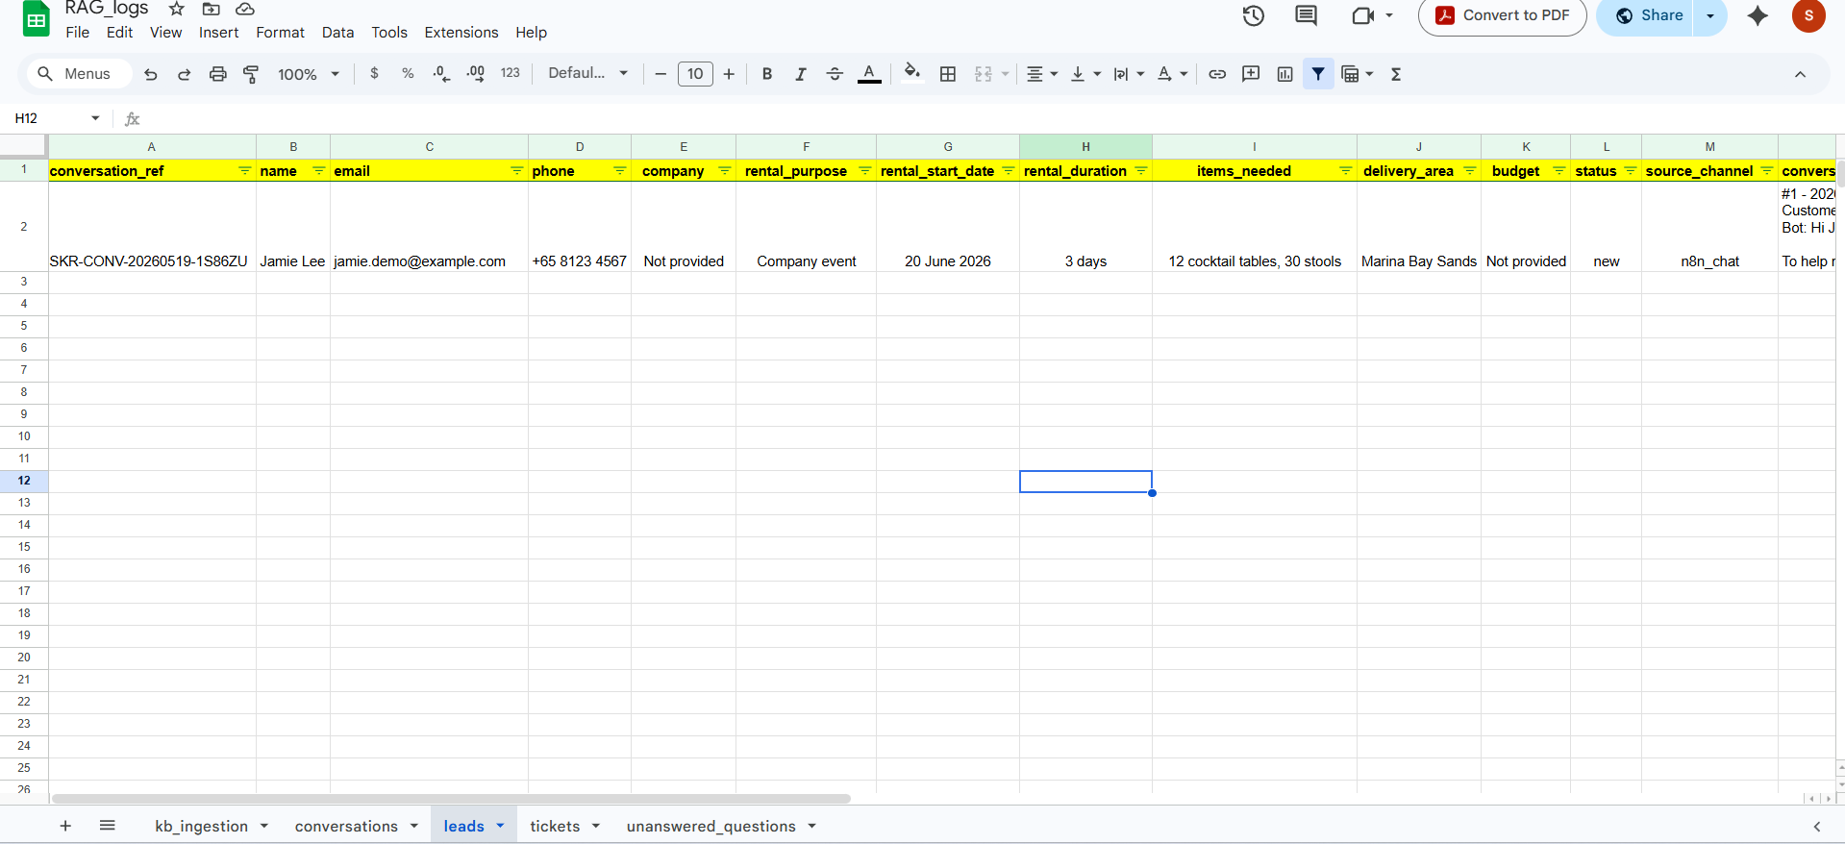
Lead Capture Log
Extracted customer and event details are written as a follow-up-ready lead record.
SpaceKonceptRental capstone evidence
12

Slide 13
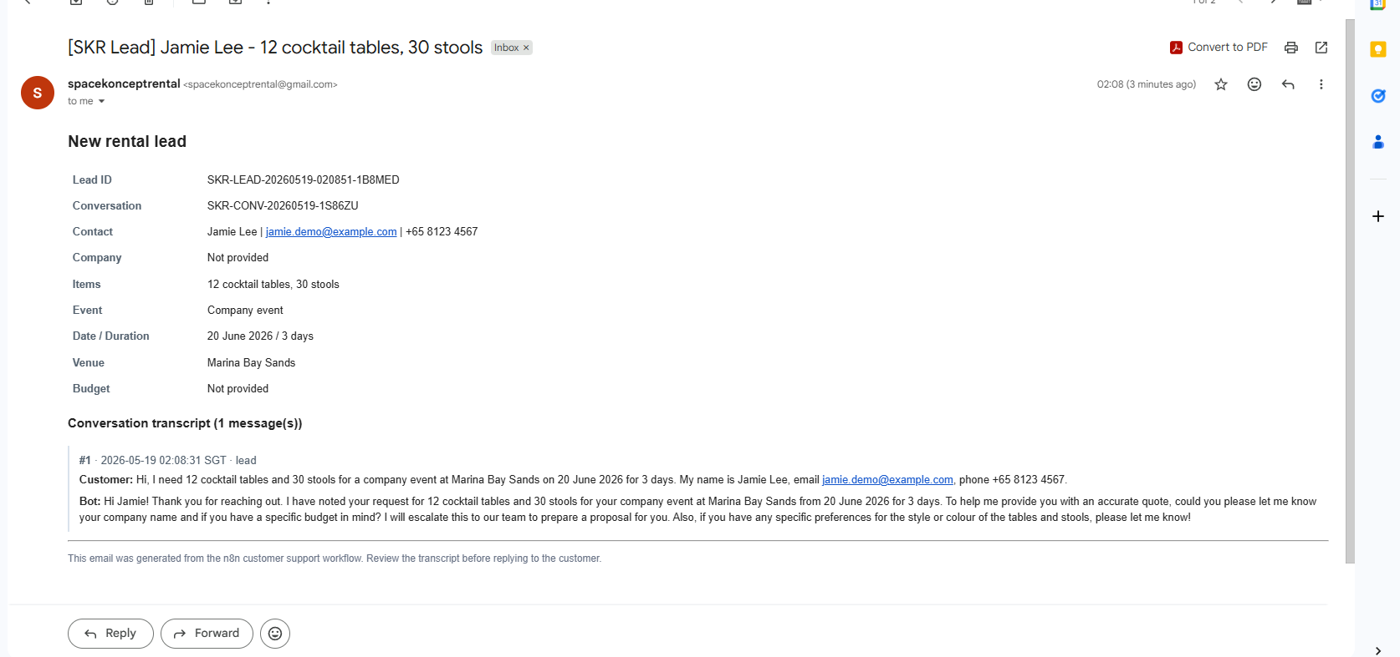
Sales Follow-Up Notification
Qualified leads are emailed to the team with customer details and the conversation transcript.
SpaceKonceptRental capstone evidence
13

Slide 14
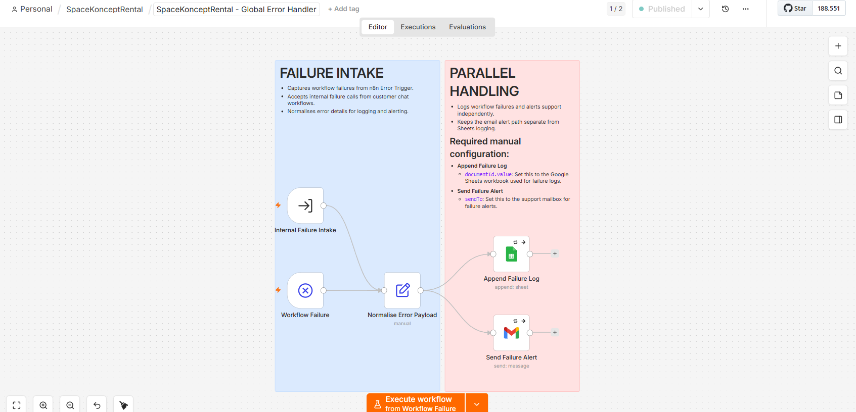
Failure Handling
Workflow errors are normalised, logged, and alerted separately from the customer-facing fallback reply.
SpaceKonceptRental capstone evidence
14

Slide 15
IMPLEMENTATION LEARNINGS
Challenges faced
The main issues were not the prompt alone; they were reliability, logging, data freshness, and graceful failure.
01
Rapid multi-message chats
02
Knowledge-base updates
Challenge: Users send one request as several quick messages. Fix: Added 5-second debounce, newest-message ownership, and merged prompt text. Lesson: Chat workflows need a small input buffer.
Challenge: Repeated file updates duplicated Pinecone chunks. Fix: Delete stale vectors by file ID or name before inserting fresh chunks. Lesson: RAG ingestion needs explicit update semantics.
03
Traceable follow-up logs
04
Customer-safe error handling
Challenge: Leads and tickets were hard to link back to the original chat. Fix: Added conversation_ref and conversation_transcript to follow-up rows. Lesson: Operational logs need human-readable audit handles.
Challenge: A workflow failure could leave the customer waiting. Fix: Split customer fallback from ops logging via the global error handler. Lesson: User recovery should not depend on the failing service.
SpaceKonceptRental capstone
15

